Slide 1
Computational Geometry

Slide 2
What is computational Geometry?
Computational geometry is a mathematical field that involves the design, analysis and implementation of efficient algorithms for solving geometric input and output problems. It is sometimes used to refer to pattern recognition and describe the solid modeling algorithms used for manipulating curves and surfaces.

Slide 3
What is computational Geometry?
Is the branch of computer science that studies algorithms for solving geometric problems.
Applications:
Computer graphics
Robotics
VLSI design
Computer Aided Design
Molecular Modeling
Metallurgy
Manufacturing
Textile layouts
Forestry
Statistics

Slide 4
A Concise History
Most geometric algorithms less than 25 years old.
1970’s-Computational Geometry started as a research discipline I the math programming, theory/algorithms and CAD communities.
Earliest papers:
Chand+kapur – Convex hull by gift wrapping
Graham – Convex hull by graham scan
Dpd+Lipton – Multidimensional searching
Shamos – geometric computing
Shamos + hoey – Voronoi Diagram
Forrest – Computational Geometry
Better names: Algorithmic geometry
Geometric Algorithms

Slide 5
Limitations
Computation-based geometry primarily deals with flat and straight objects.
The field mostly focuses on two-dimensional problems, which are easy to visualize and understand.
Notes:
There are reasons why computational based theory never fully meets the needs of practioners and their application areas.
it struggles to meet the needs of engineers and designers who deal with robotics, fluid dynamics and solid modeling.
hindi lang nman lahat straight lines at flat surfaces ung mga ginagamit sa modelling
The good news is that technology allows computational geometrists to deal with curved objects with polygons or polyhedra.
imits the ability to tackle the most daunting three-dimensional application problems and higher dimensional spaces.

Slide 6
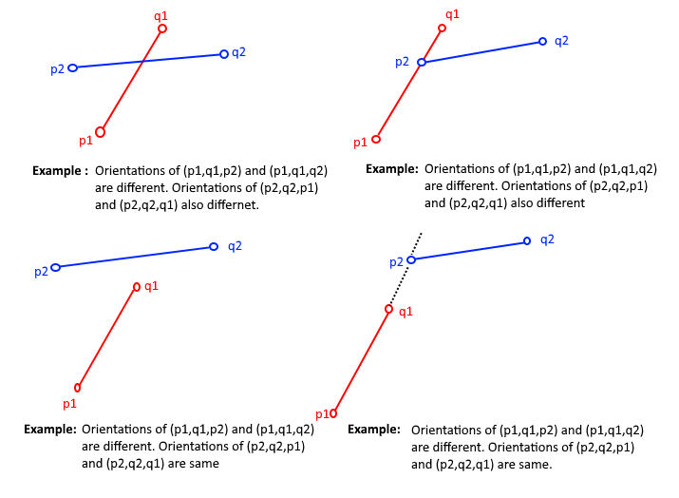
Intersection of lines – Detection of common parts of objects – Usually linear (line segments, polygons, n-gons,…)

Slide 7
p1 x p2=|x1 x2| = (x1y2) - (x2-y1) = -p2 x p1
|y1 y2|
If p1 x p2 is positive the p1 is clockwise from p2 with respect to origin (0,0) and if p1 x p2 is negative then p1 is counterclockwise fro, p2 with respect to origin(0,0)
If cross product is zero then vectors p1 and p2 are collinear pointing in either the same or opposite direction.

Slide 8
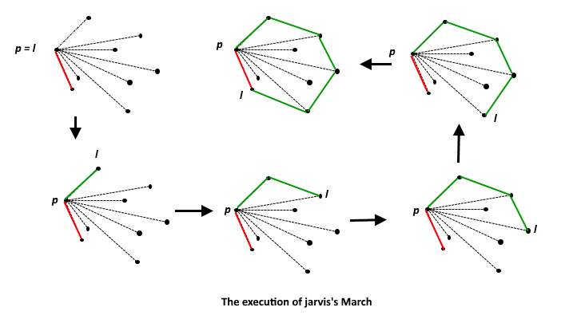
Convex Hull | Set 1 (Jarvis’s Algorithm or Wrapping)
Given a set of points in the plane. the convex hull of the set is the smallest convex polygon that contains all the points of it

Slide 9
The idea of Jarvis’s Algorithm is simple, we start from the leftmost point (or point with minimum x coordinate value) and we keep wrapping points in counterclockwise direction.

Slide 10
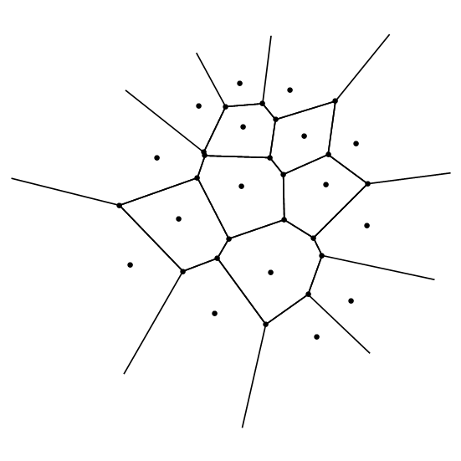
Voronoi diagrams – Space (plane) partitioning into regions whose points are nearest to the given primitive (most usually a point)

Slide 11
How to find the answers
Prove hard and interesting theorems
Develop ideas and then look for a problem that needs these ideas.
Build environments in which it is easier to prove theorems.
Consider a problem from an application and look for methods that can be used to solve it.
Implement an algorithm, publicize your code and ask people how they use it.
Build environments in which it is easier to implement algorithms.

